Slide 1
Review of C++ Programming
Part II
Sheng-Fang Huang

Slide 2
Composition: Objects as Members of Classes
Composition
  A class can have objects of other classes as members
    Example
      AlarmClock object with a Time object as a member
  A common form of software reusability is composition, in which a class has objects of other classes as members.

Slide 3
Composition: Objects as Members of Classes
Initializing member objects
  Member initializers pass arguments from the object’s constructor to member-object constructors
  If a member initializer is not provided
    A compilation error occurs if the member object’s class does not provide any proper constructor.

Slide 4
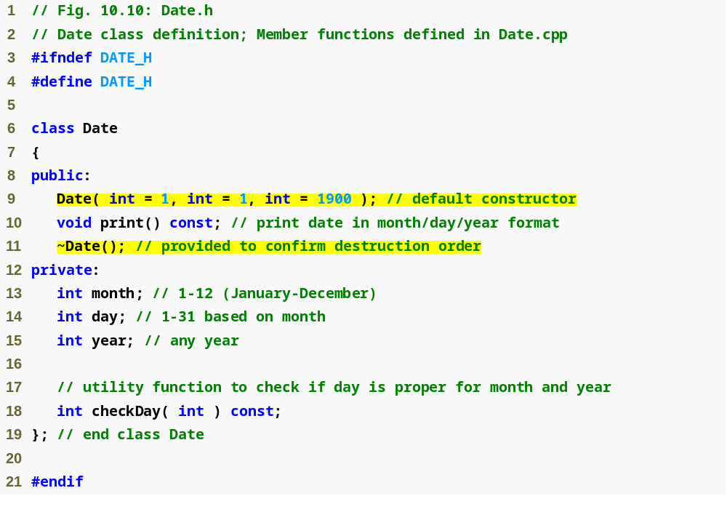

Slide 5
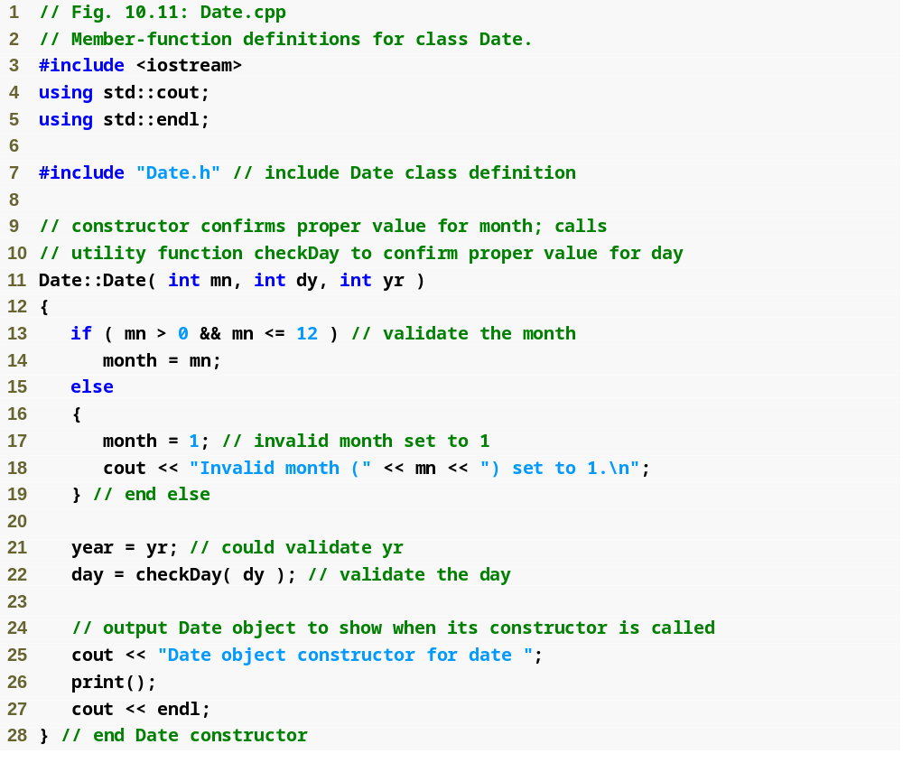

Slide 6
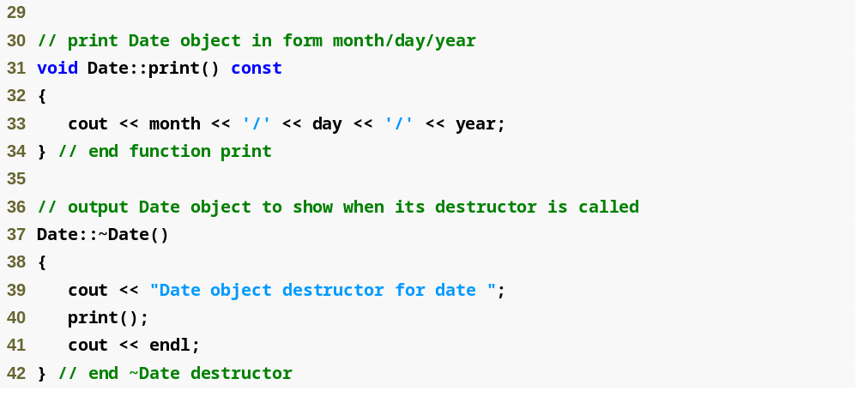

Slide 7
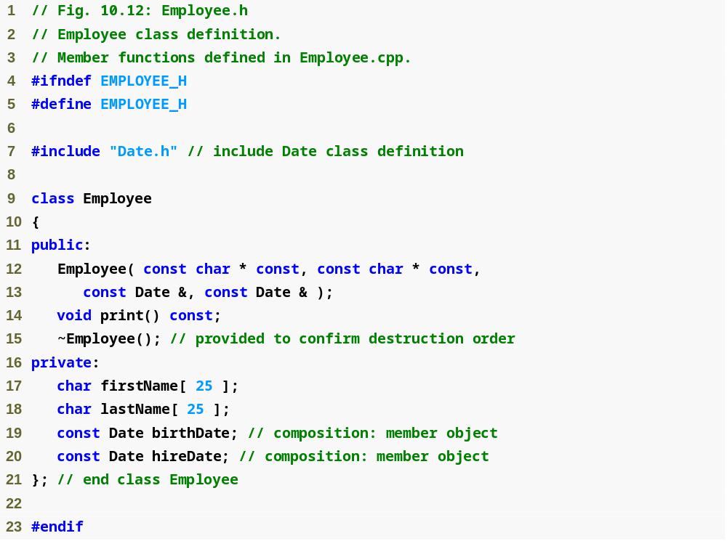
Parameters to be passed via member initializers to the constructor for class Date
const objects of class Date as members

Slide 8
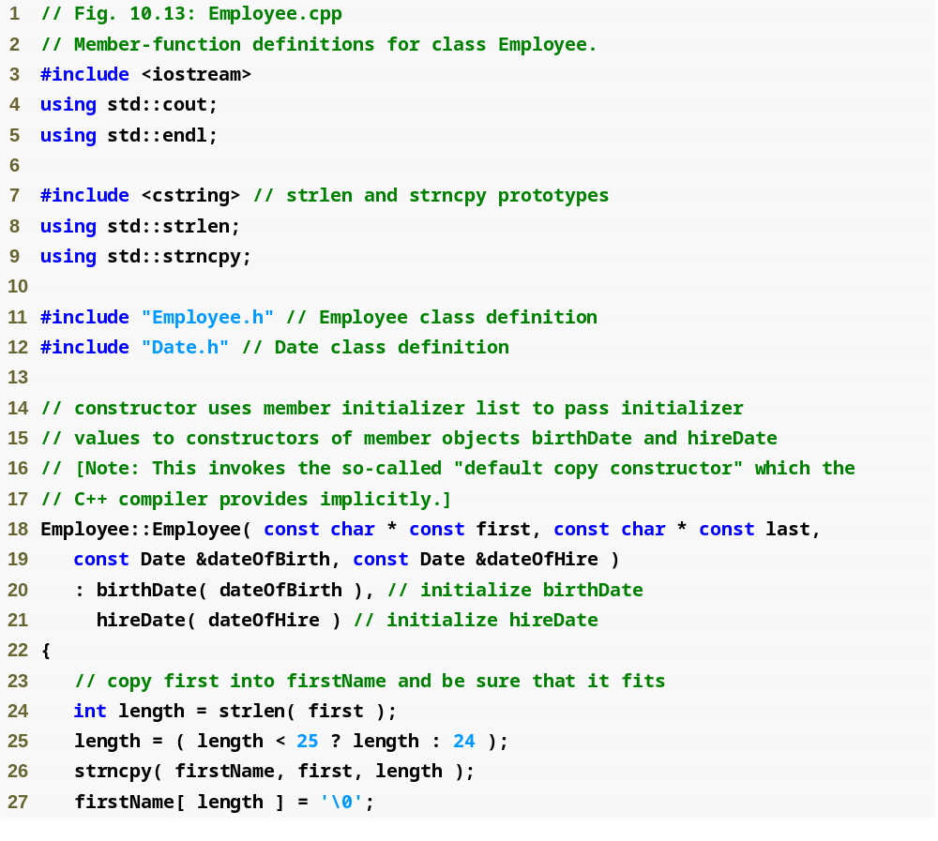
Member initializers that pass arguments to Date’s implicit default copy constructor

Slide 9
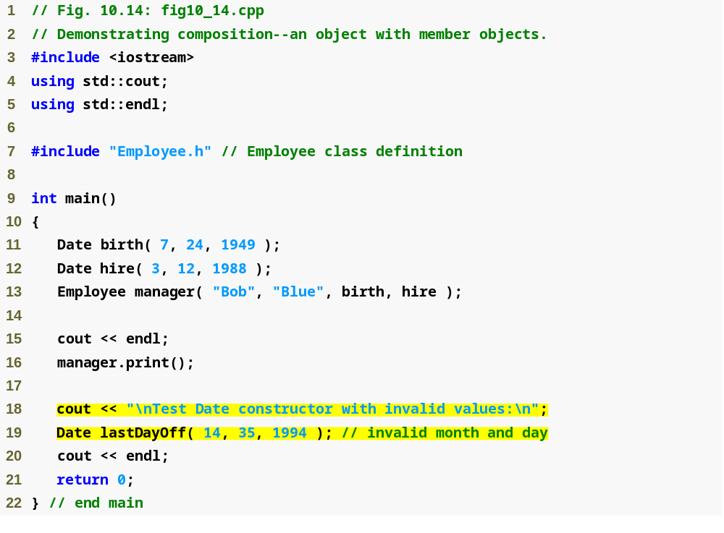
Passing objects to a host object constructor

Slide 10
friend
To declare a function as a friend of a class:
  Provide the function prototype in the class definition preceded by keyword friend.
To declare a class as a friend of a class:
  Place a declaration of the form
  friend class ClassTwo;
  in the definition of class ClassOne
    All member functions of class ClassTwo are friends of class ClassOne

Slide 11
friend Classes
Friendship is granted, not taken
  For class B to be a friend of class A, class A must explicitly declare that class B is its friend
Friendship relation is neither symmetric nor transitive
  If class A is a friend of class B, and class B is a friend of class C, you cannot infer that class B is a friend of class A, that class C is a friend of class B, or that class A is a friend of class C
Place all friendship declarations first inside the class definition’s body and do not precede them with any access specifier.

Slide 12
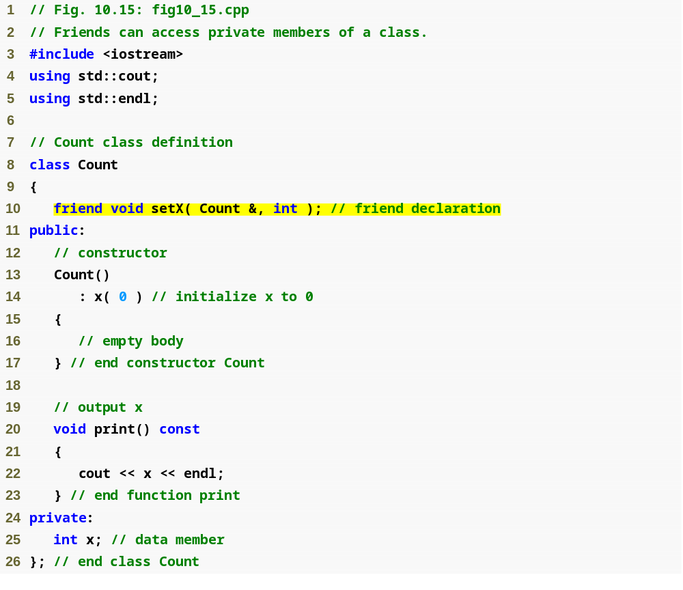
friend function declaration (can appear anywhere in the class)

Slide 13
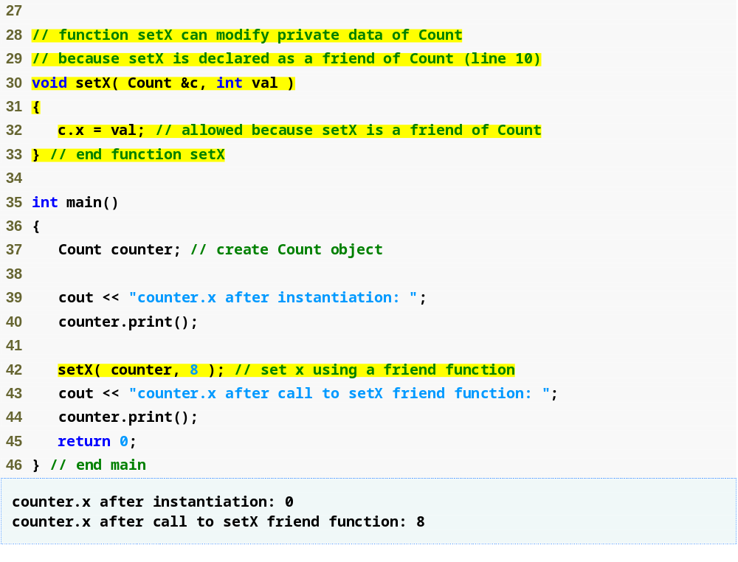
friend function can modify Count’s private data
Calling a friend function; note that we pass the Count object to the function

Slide 14
Dynamic Memory Management with Operators new and delete
Dynamic memory management
  Enables programmers to allocate and deallocate memory for any built-in or user-defined type
  Performed by operators new and delete
  For example, dynamically allocating memory for an array instead of using a fixed-size array

Slide 15
Dynamic Memory Management with Operators new and delete
Operator new
  Allocates (i.e., reserves) storage of the proper size for an object at execution time
  Calls a constructor to initialize the object
  Returns a pointer of the type specified to the right of new
  Can be used to dynamically allocate any fundamental type (such as int or double) or any class type
Heap
  Region of memory assigned to each program for storing objects created at execution time

Slide 16
Dynamic Memory Management with Operators new and delete
Operator delete
  Destroys a dynamically allocated object
  Calls the destructor for the object
  Deallocates (i.e., releases) memory from the heap
  The memory can then be reused by the system to allocate other objects
    Not releasing dynamically allocated memory when it is no longer needed can cause the system to run out of memory prematurely. This is sometimes called a “memory leak.”

Slide 17
Dynamic Memory Management with Operators new and delete
new operator can be used to allocate arrays dynamically
  Dynamically allocate a 10-element integer array:
  int *gradesArray = new int[ 10 ];
  Size of a dynamically allocated array
    Specified using any integral expression that can be evaluated at execution time

Slide 18
Dynamic Memory Management with Operators new and delete
Delete a dynamically allocated array:
  delete [] gradesArray;
  If the pointer points to an array of objects
    First calls the destructor for every object in the array
    Then deallocates the memory
  If the statement did not include the square brackets ([]) and gradesArray pointed to an array of objects
    Only the first object in the array would have a destructor call

Slide 19
static Class Members
static data member
  Only one copy of a variable shared by all objects of a class
    “Class-wide” information
    A property of the class shared by all instances, not a property of a specific object of the class
  Declaration begins with keyword static

Slide 20
static Class Members
static member function
  Is a service of the class, not of a specific object of the class
static applied to an item at file scope
  That item becomes known only in that file
  The static members of the class need to be available from any client code that accesses the file
    So we cannot declare them static in the .cpp file—we declare them static only in the .h file.

Slide 21
static Class Members
Use static data members to save storage when a single copy of the data for all objects of a class will suffice.
A class’s static data members and static member functions exist and can be used even if no objects of that class have been instantiated.

Slide 22
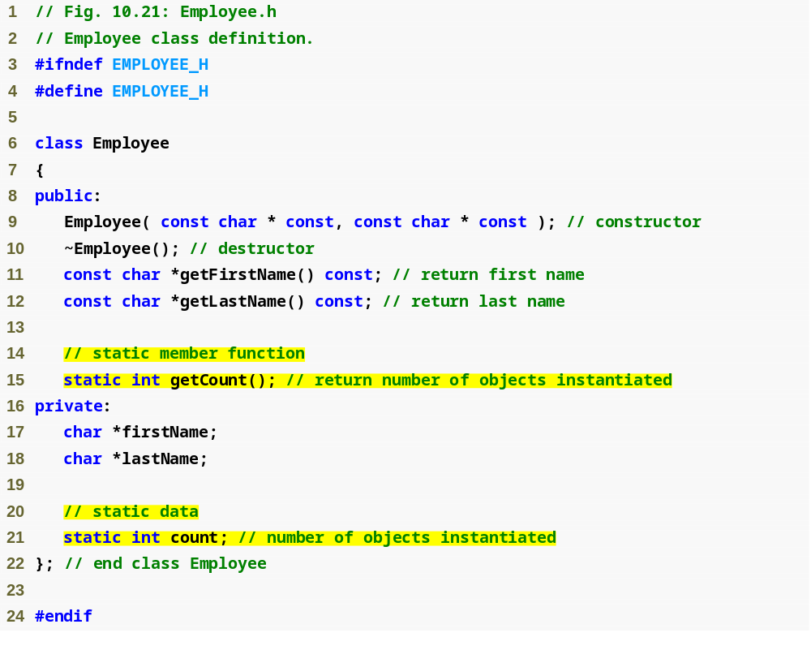
Function prototype for static member function
static data member keeps track of number of Employee objects that currently exist

Slide 23
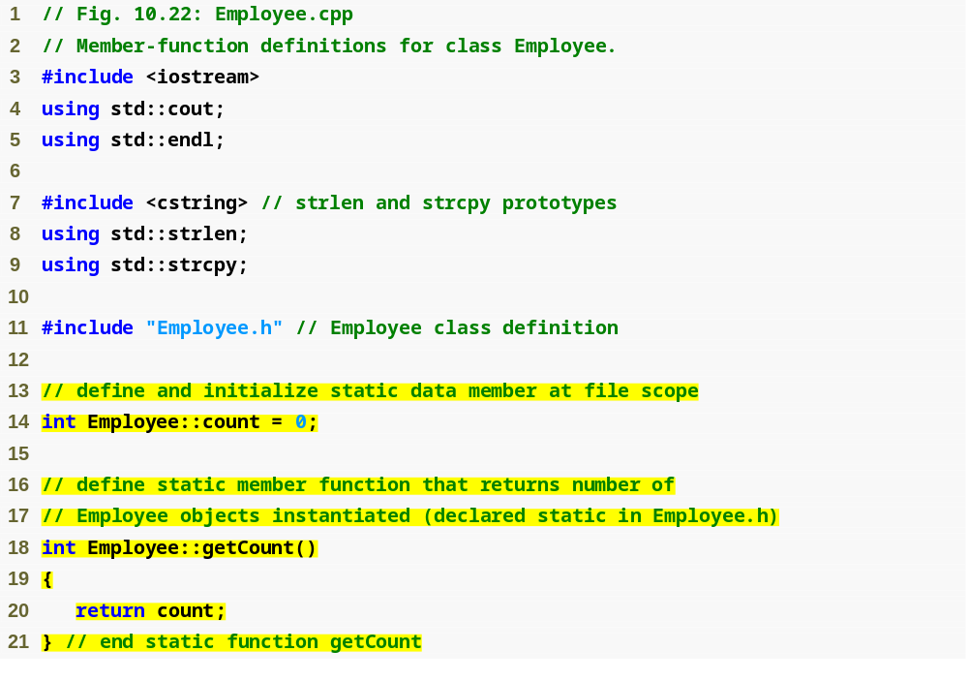
static data member is defined and initialized at file scope in the .cpp file
static member function can access only static data, because the function might be called when no objects exist

Slide 24
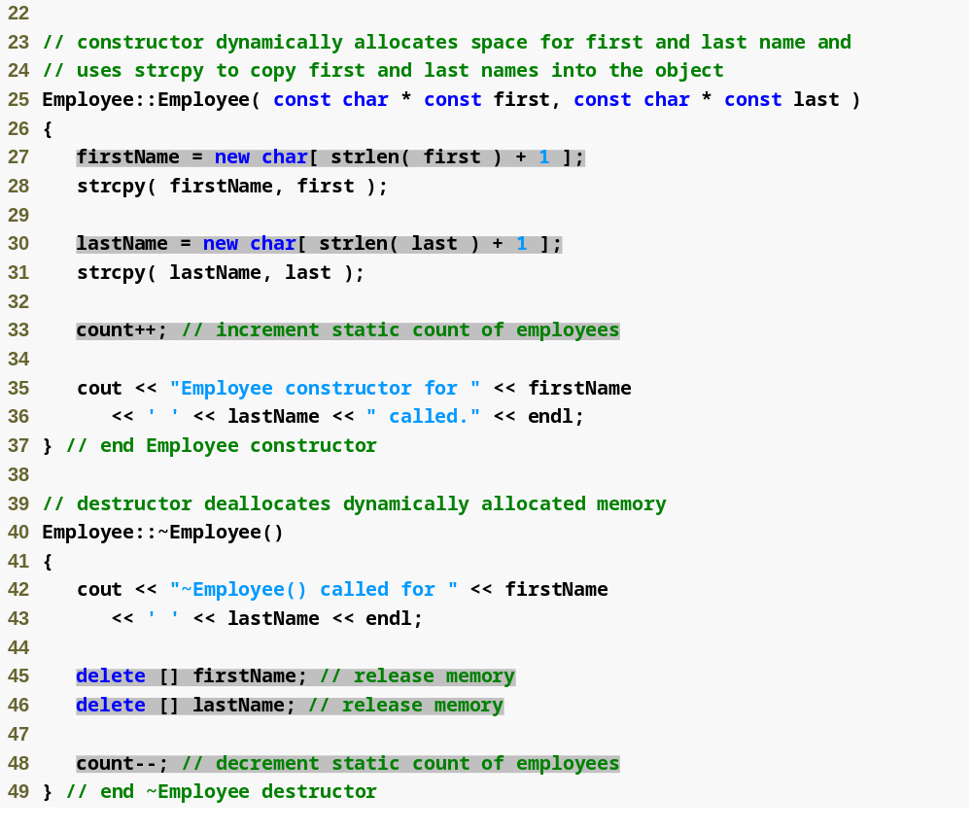
Non-static member function (i.e., constructor) can modify the class’s static data members

Slide 25
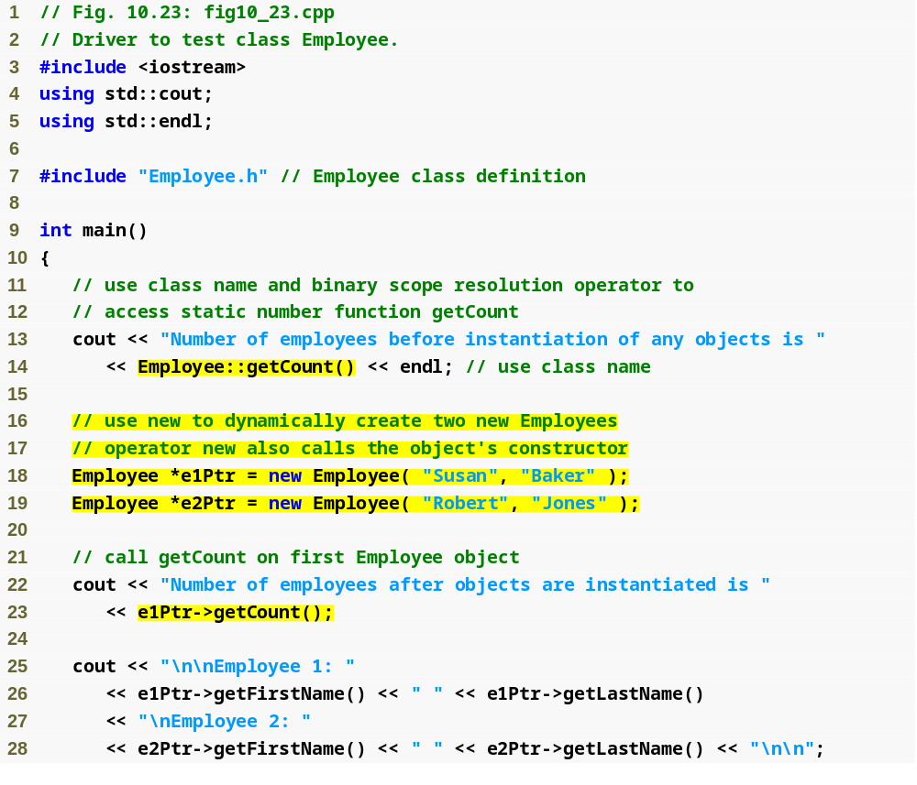
Calling static member function using class name and binary scope resolution operator
Dynamically creating Employees with new
Calling a static member function through a pointer to an object of the class

Slide 26
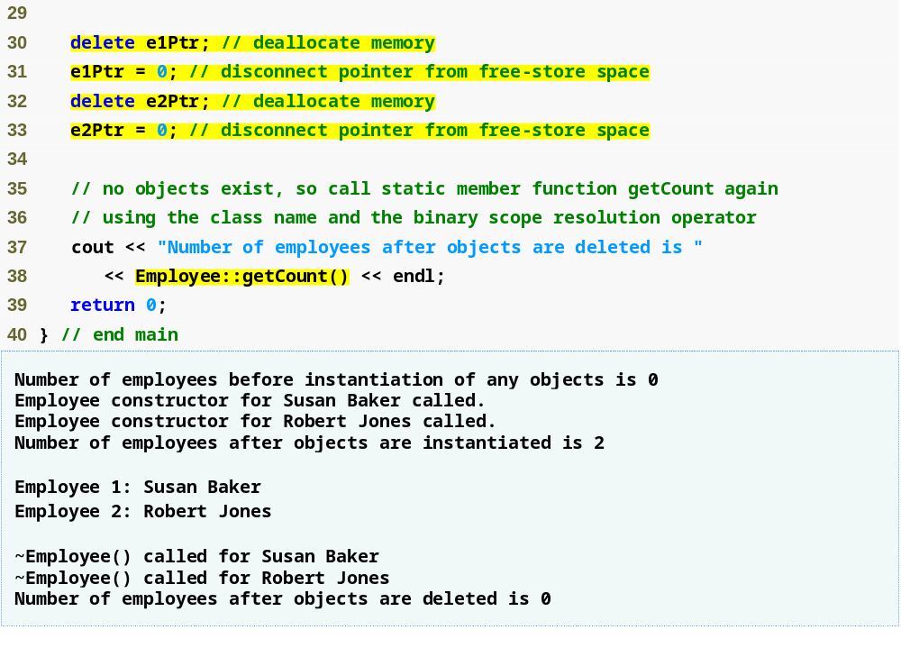

Slide 27
Fundamentals of Operator Overloading
Types for operator overloading
  Built in (int, char) or user-defined (classes)
  Can use existing operators with user-defined types
    Cannot create new operators
Overloading operators
  Create a function for the class
  Operator overloading contributes to C++’s extensibility—one of the language’s most appealing attributes

Slide 28
Overloading Stream Insertion and Stream Extraction Operators
<< and >> operators
  Already overloaded to process each built-in type
  Can also process a user-defined class
    Overload using global, friend functions
Example program
  Class PhoneNumber
    Holds a telephone number
  Print out formatted number automatically
    (123) 456-7890

Slide 29
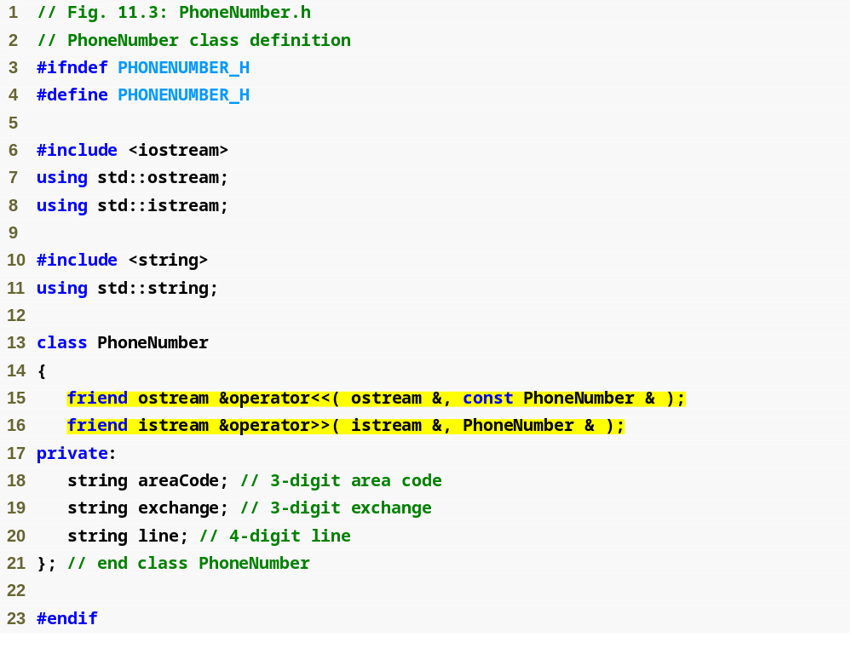
Notice function prototypes for overloaded operators >> and << (must be global, friend functions)

Slide 30
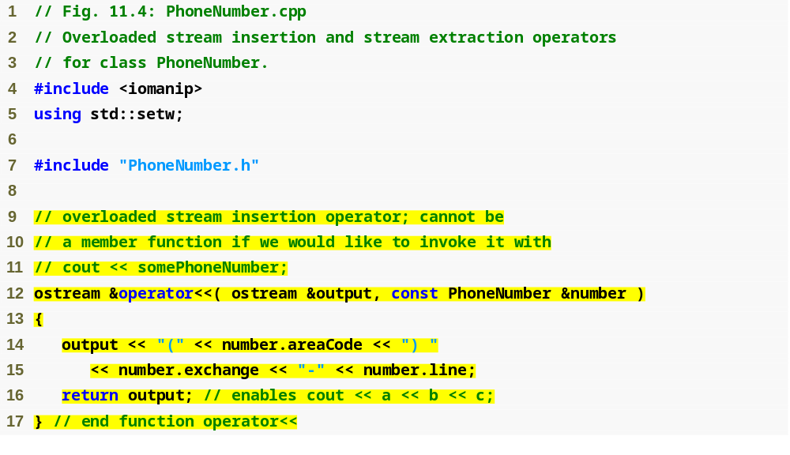
Allows cout << phone; to be interpreted as: operator<<(cout, phone);
Display formatted phone number

Slide 31
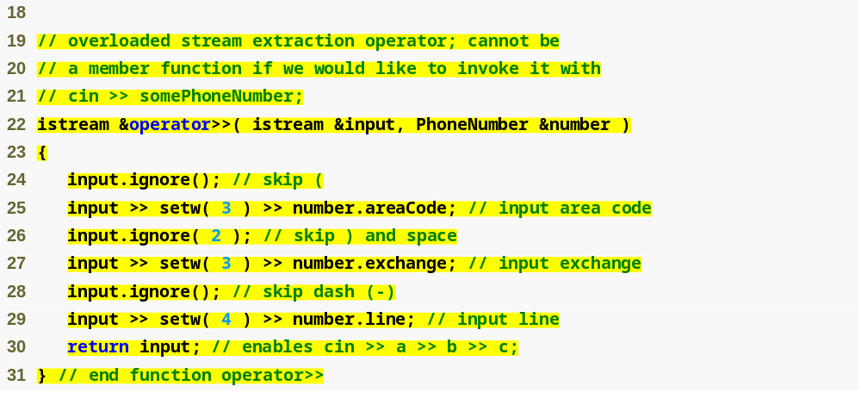
ignore skips specified number of characters from input (1 by default)
Input each portion of phone number separately

Slide 32
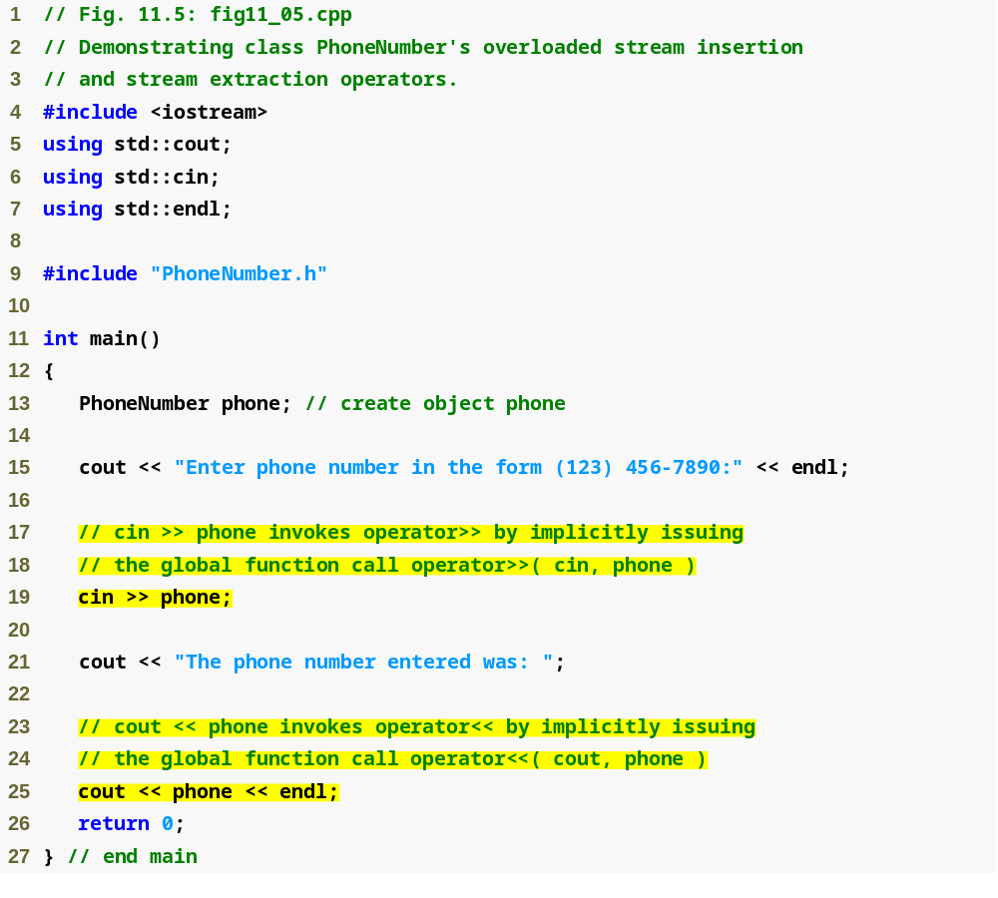
Testing overloaded >> and << operators to input and output a PhoneNumber object

Slide 33
Overloading Unary Operators
Overloading unary operators
  Can overload as non-static member function with no arguments
  Can overload as global function with one argument
    Argument must be class object or reference to class object
  Remember, static functions only access static data

Slide 34
Overloading Unary Operators
Overload ! to test for empty string
  If non-static member function, needs no arguments
    class String
    {
    public:
    bool operator!() const;
    …
    };
    !s becomes s.operator!()
  If global function, needs one argument
    bool operator!( const String & )
    s! becomes operator!(s)

Slide 35
Overloading Binary Operators
Overloading binary operators
  Non-static member function, one argument
  Global function, two arguments
    One argument must be class object or reference

Slide 36
Overloading Binary Operators
Overloading +=
  If non-static member function, needs one argument
    class String
    {
    public:
    const String & operator+=( const String & );
    …
    };
    y += z becomes y.operator+=( z )
  If global function, needs two arguments
    const String &operator+=( String &, const String & );
    y += z becomes operator+=( y, z )

Slide 37
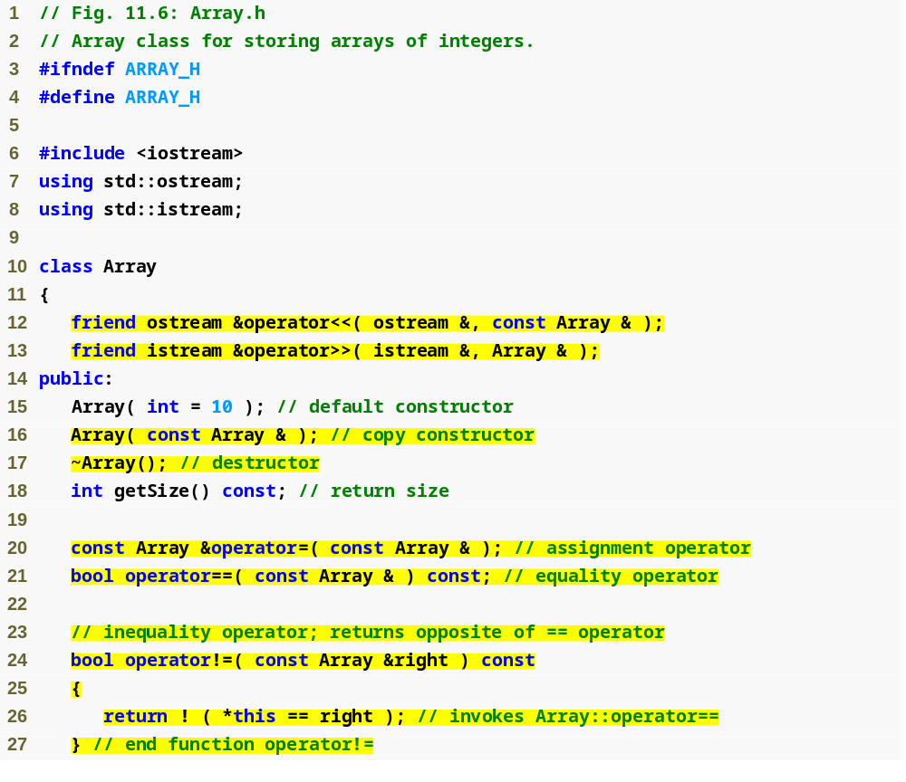
Most operators overloaded as member functions (except << and >>, which must be global functions)
Prototype for copy constructor
!= operator simply returns opposite of == operator – only need to define the == operator

Slide 38
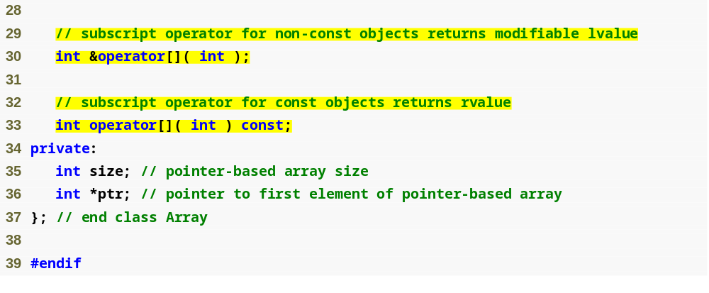
Operators for accessing specific elements of Array object

Slide 39
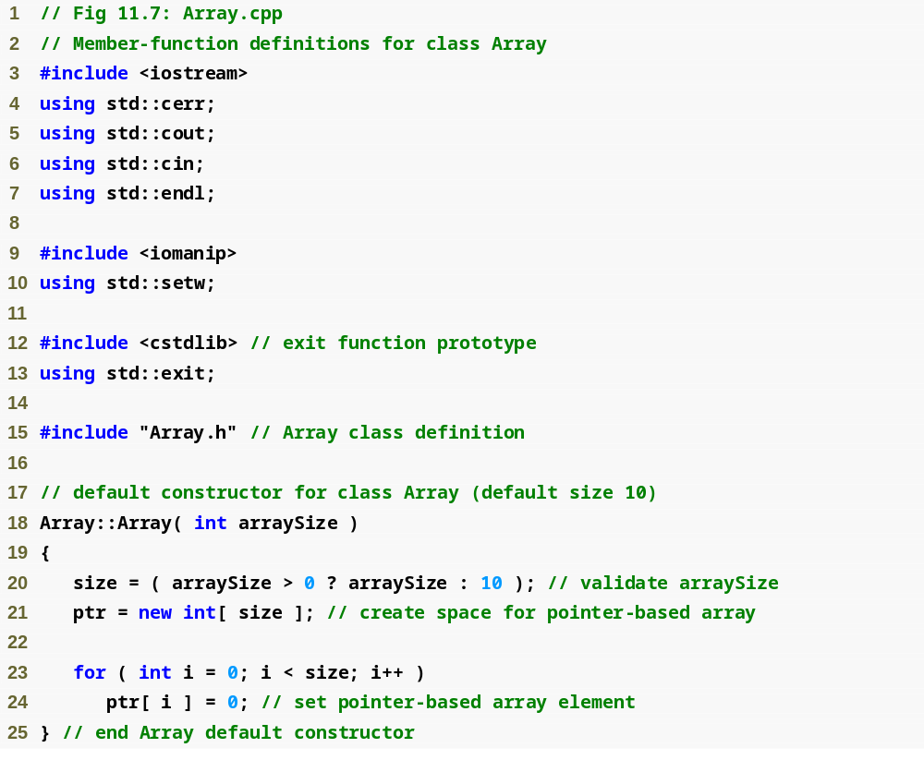

Slide 40
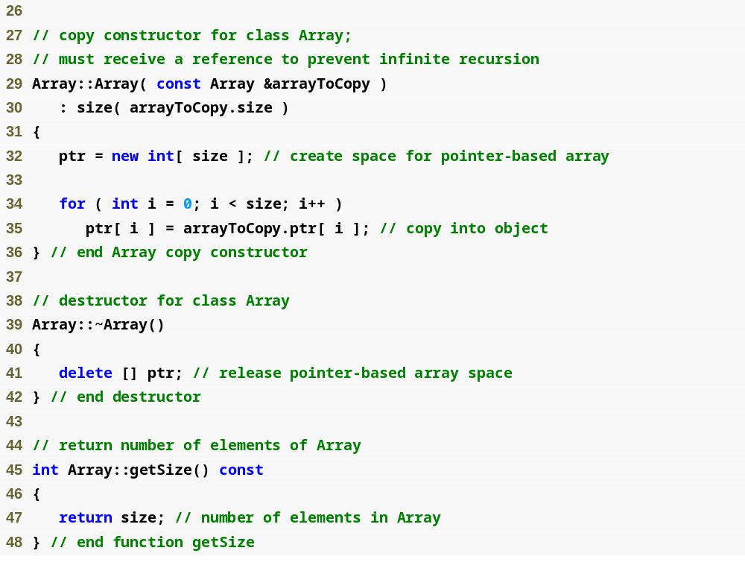
We must declare a new integer array so the objects do not point to the same memory

Slide 41
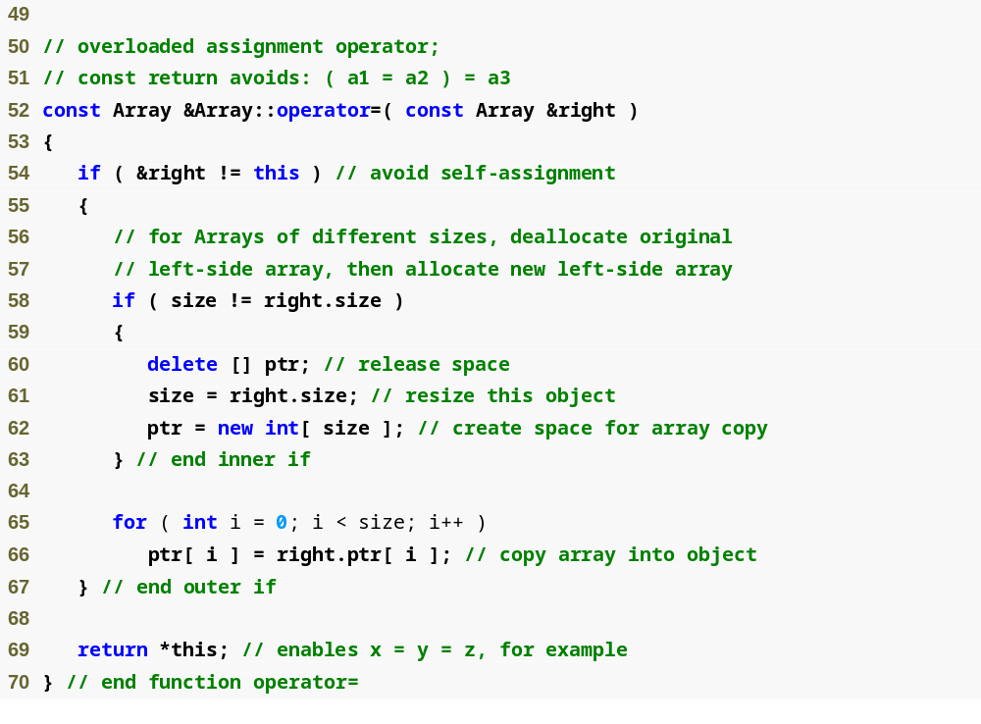
Want to avoid self assignment
This would be dangerous if this is the same Array as right

Slide 42
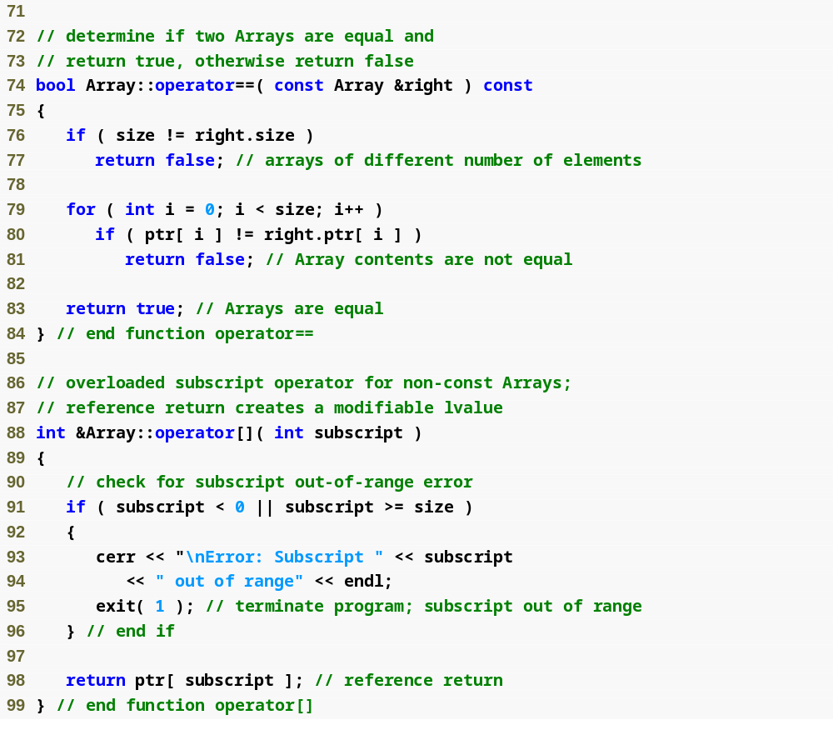
integers1[ 5 ] calls integers1.operator[]( 5 )

Slide 43
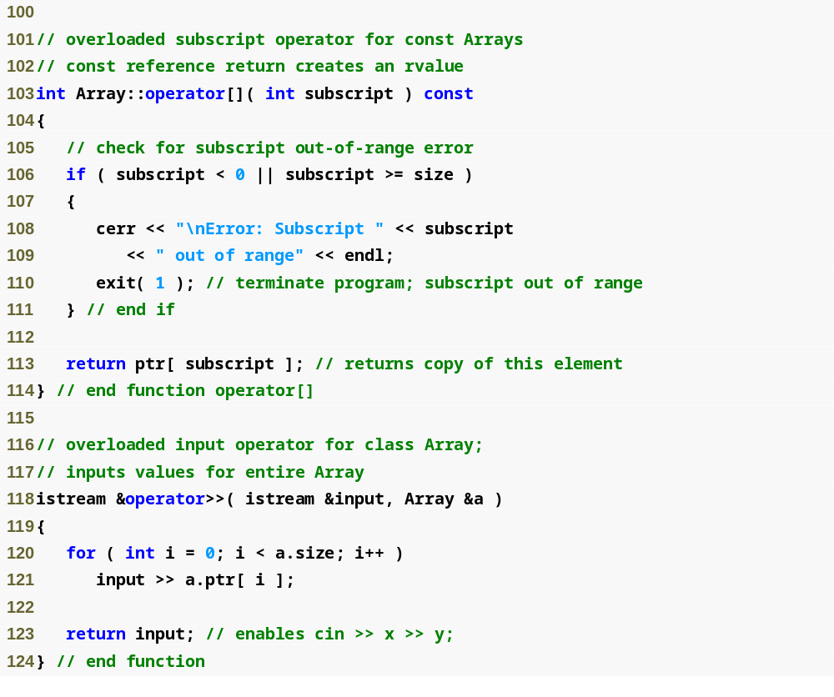

Slide 44
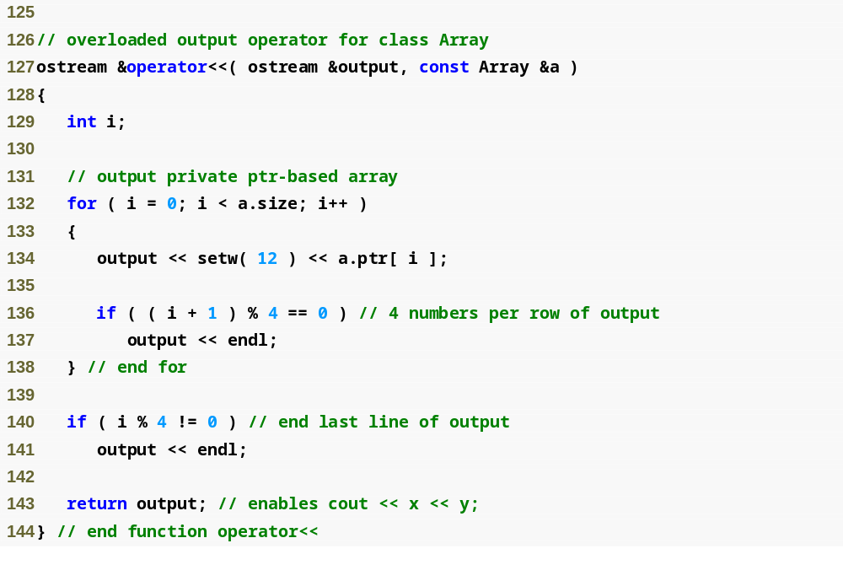

Slide 45
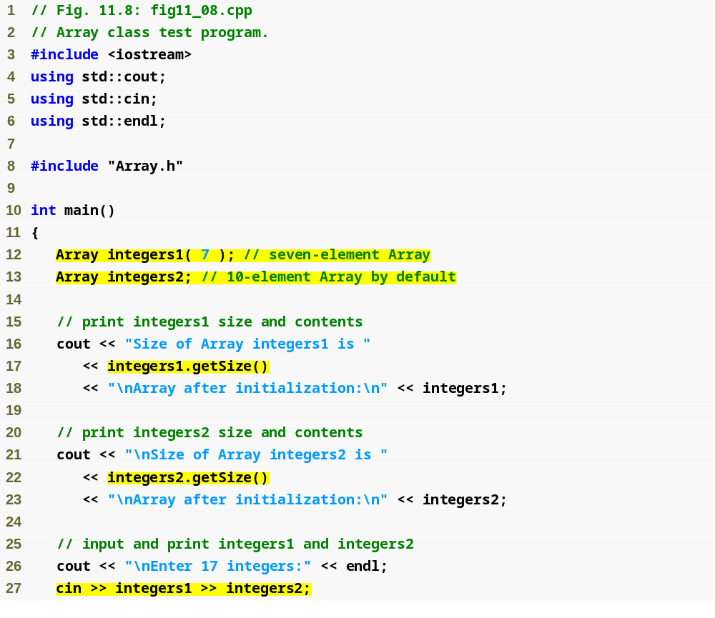
Retrieve number of elements in Array
Use overloaded >> operator to input

Slide 46
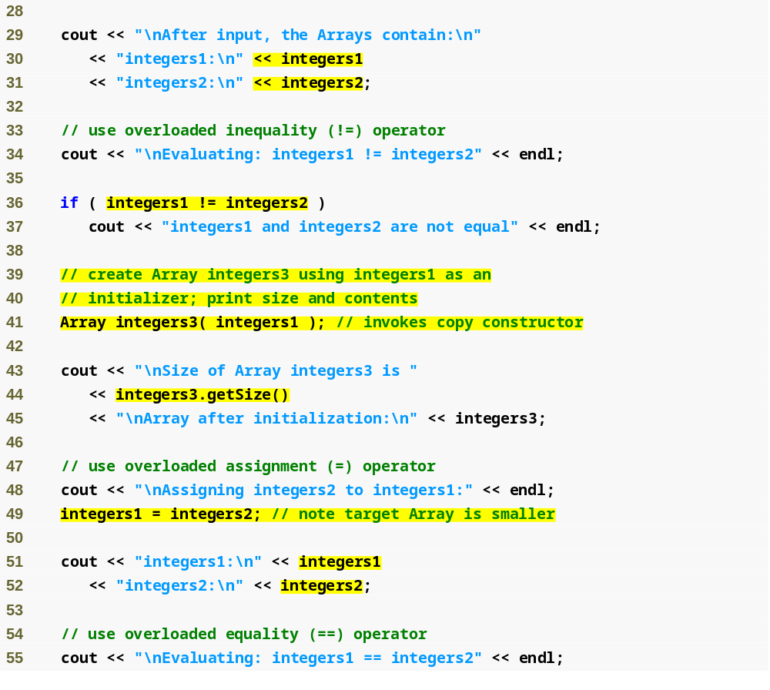
Use overloaded << operator to output
Use overloaded != operator to test for inequality
Use copy constructor
Use overloaded = operator to assign

Slide 47
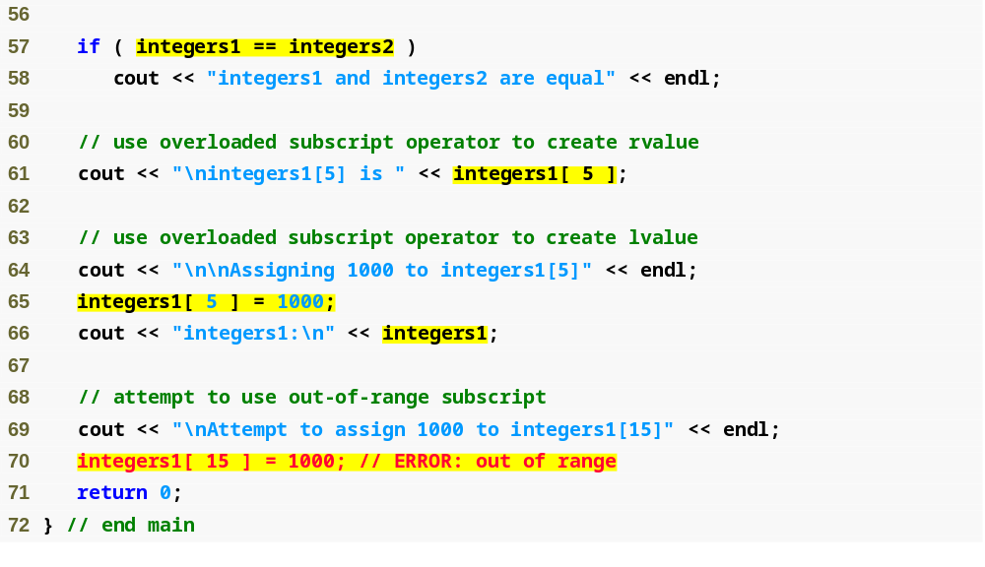
Use overloaded == operator to test for equality
Use overloaded [] operator to access individual integers, with range-checking

Slide 48
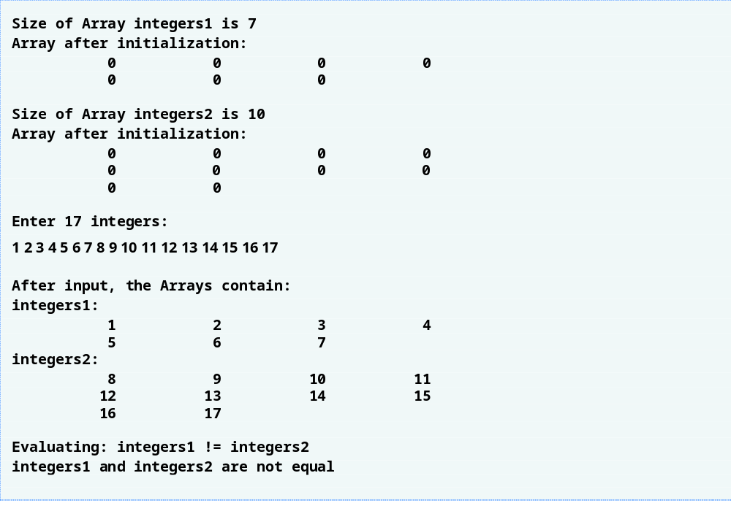

Slide 49
